Slide 2

HELLO!
I am Louis Weisz
I’m a Data Analyst and a science YouTuber.
You can find me at @WeiszCracks

Slide 3
Behind The Algorithm:
An Analysis of Youtube’s Trending Tab

Slide 4
What is “Trending”?

Slide 5
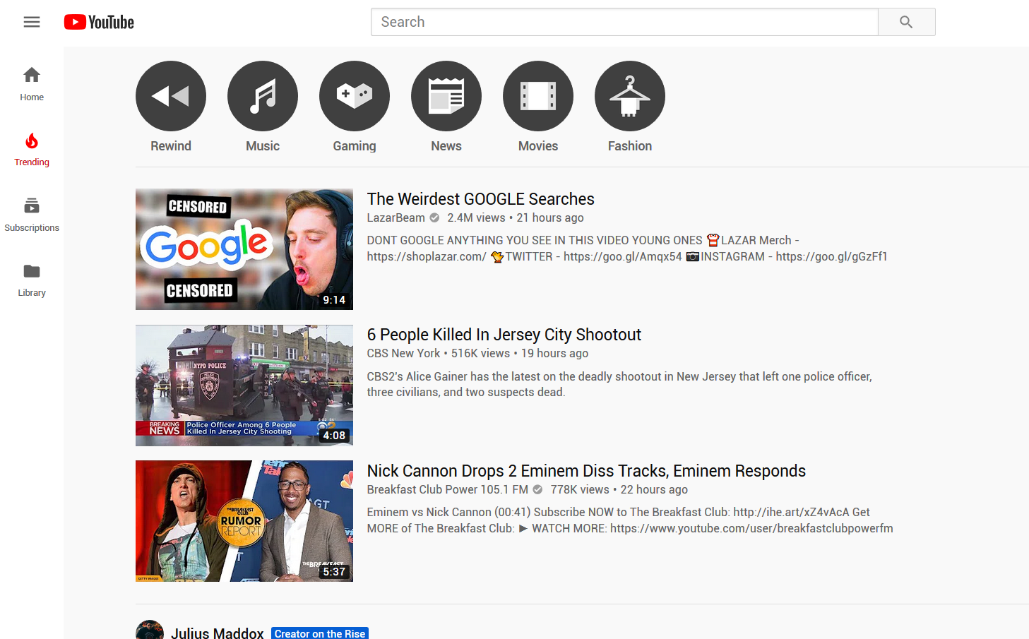

Slide 6
Why Research Trending?
It’s the only part of youtube that isn’t personalized.

Slide 7
Originally I wanted to predict what makes videos land on Trending.

Slide 8
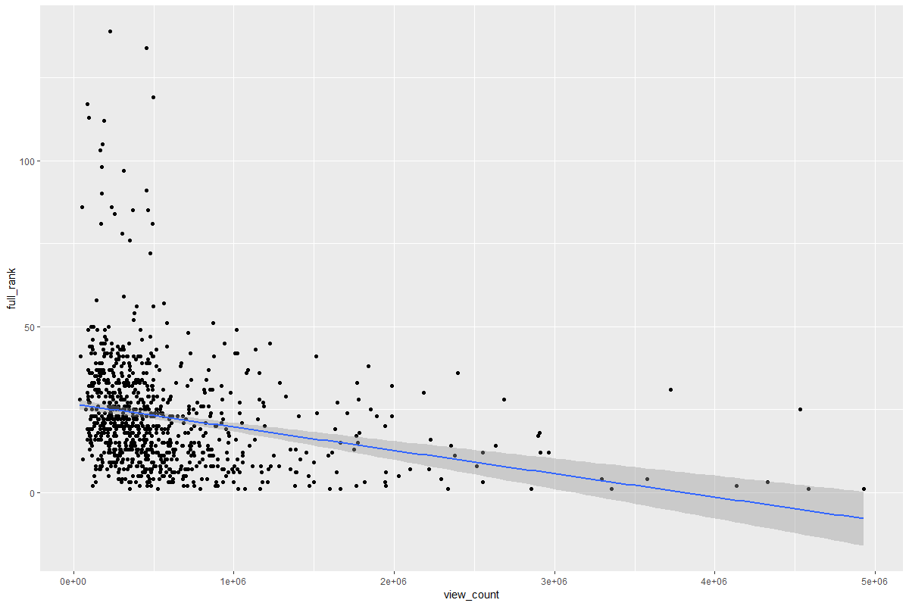
Video debut trending rank vs view count

Slide 9
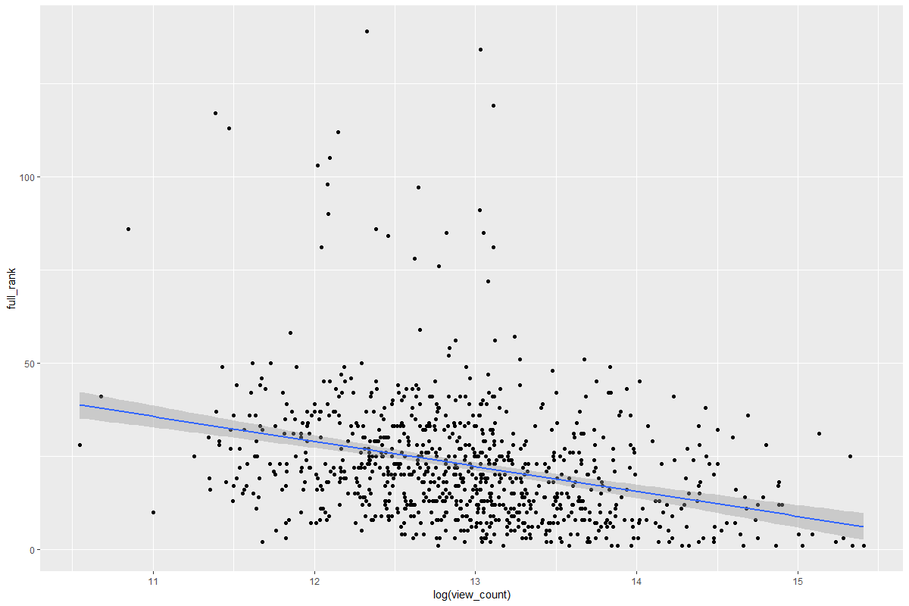
Video debut rank vs log(view count)

Slide 10
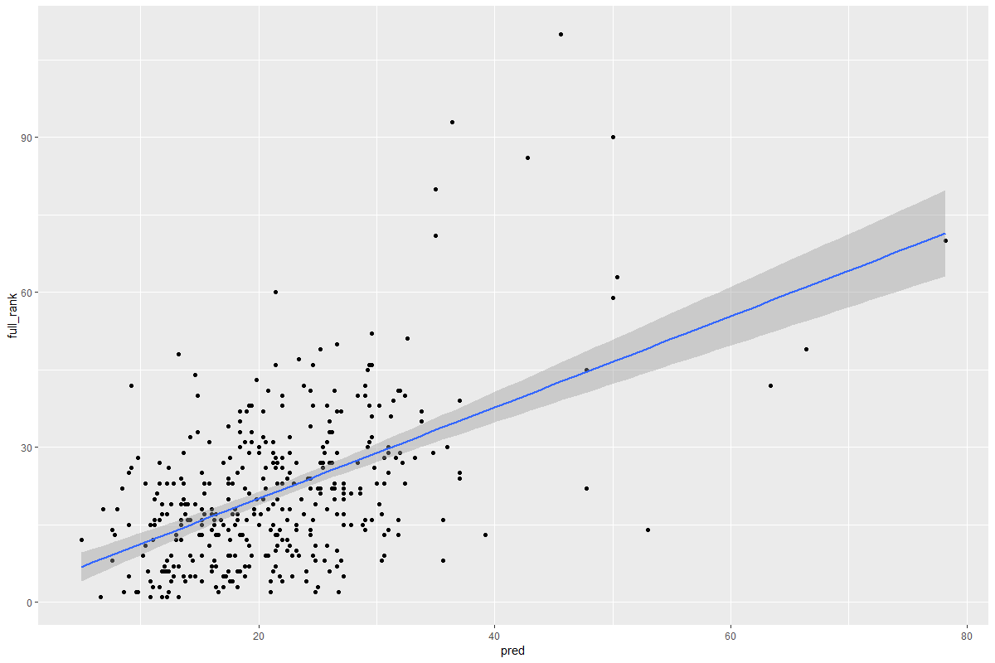
Debut rank knn predictions

Slide 11
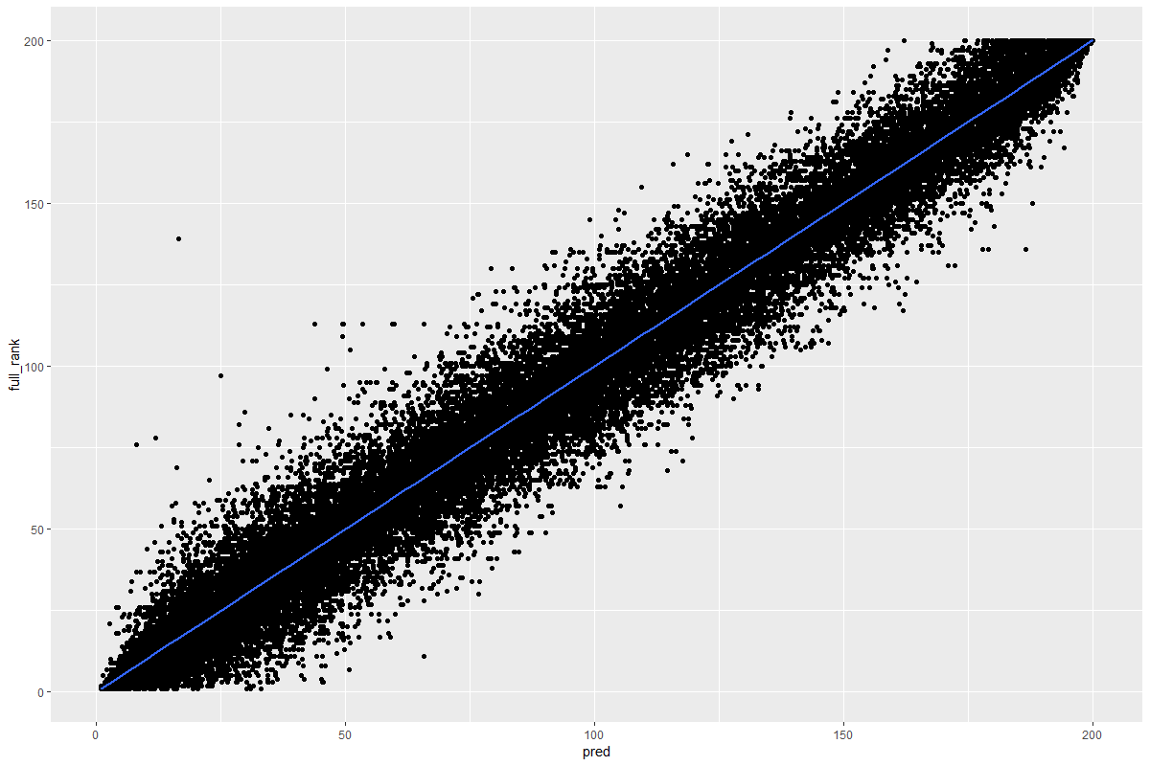
Rolling KNN rank predictions

Slide 12
But I really want to tell you about the part I find
Interesting, which is that we now have possibly
The best view ever of what makes the trending tab tick.

Slide 13
What “trending” really means

Slide 14
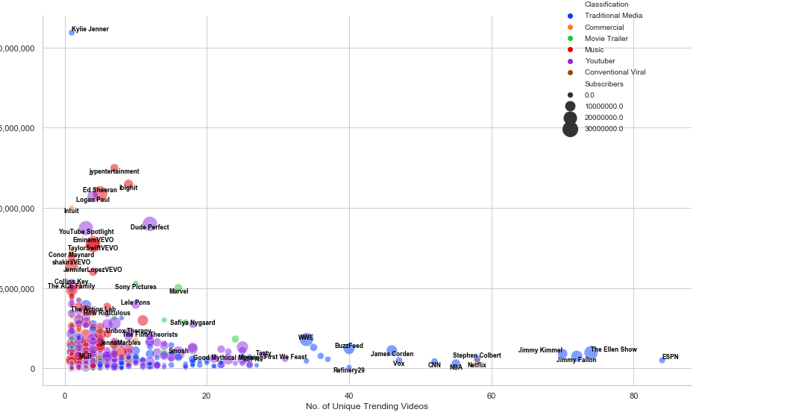

Slide 15
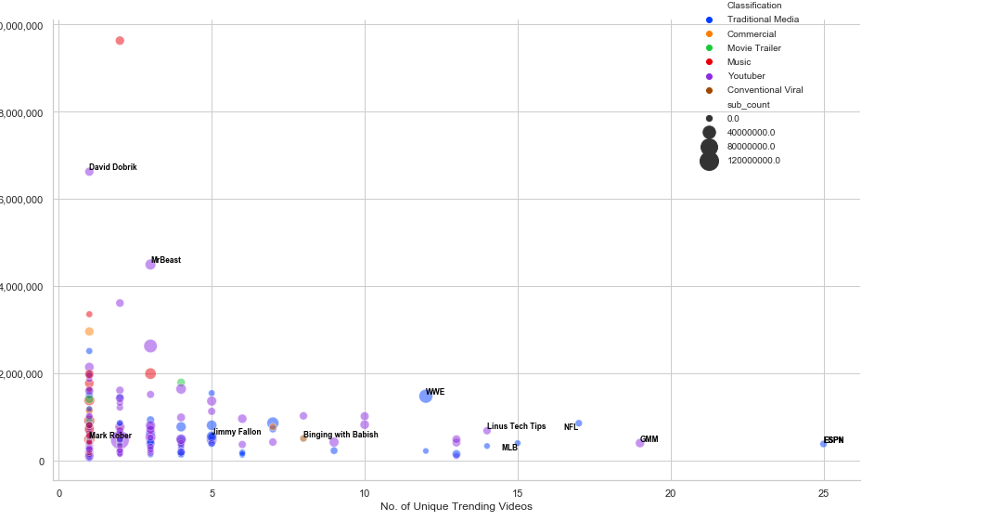

Slide 16
Do videos “Trend” because
they’re popular,
or do they become popular
because of trending?

Slide 17
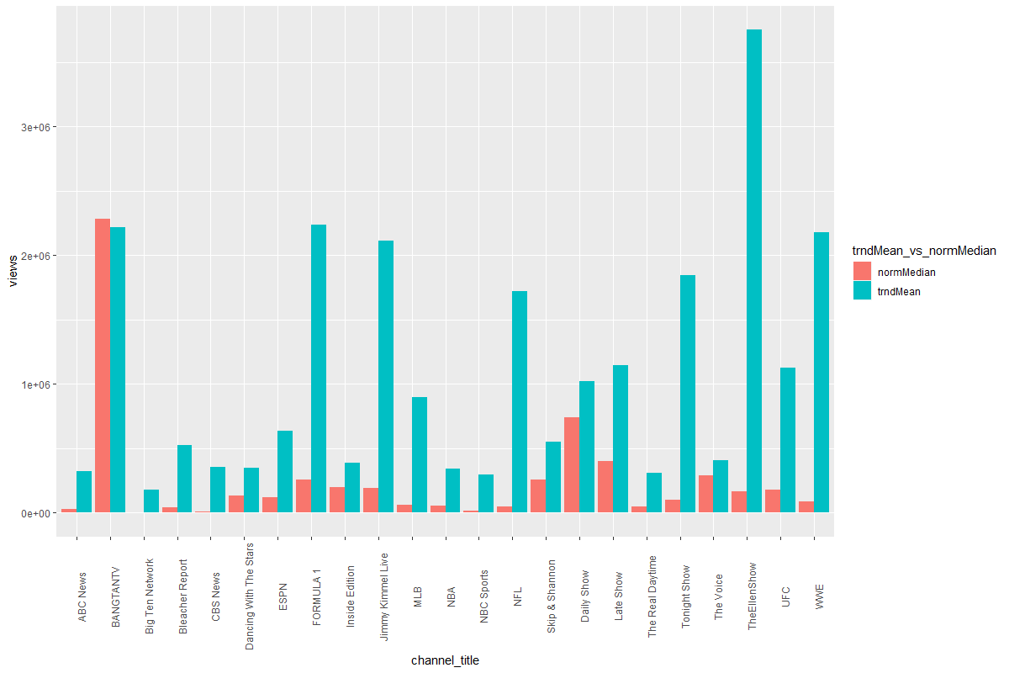
Trad. media views comparison

Slide 18
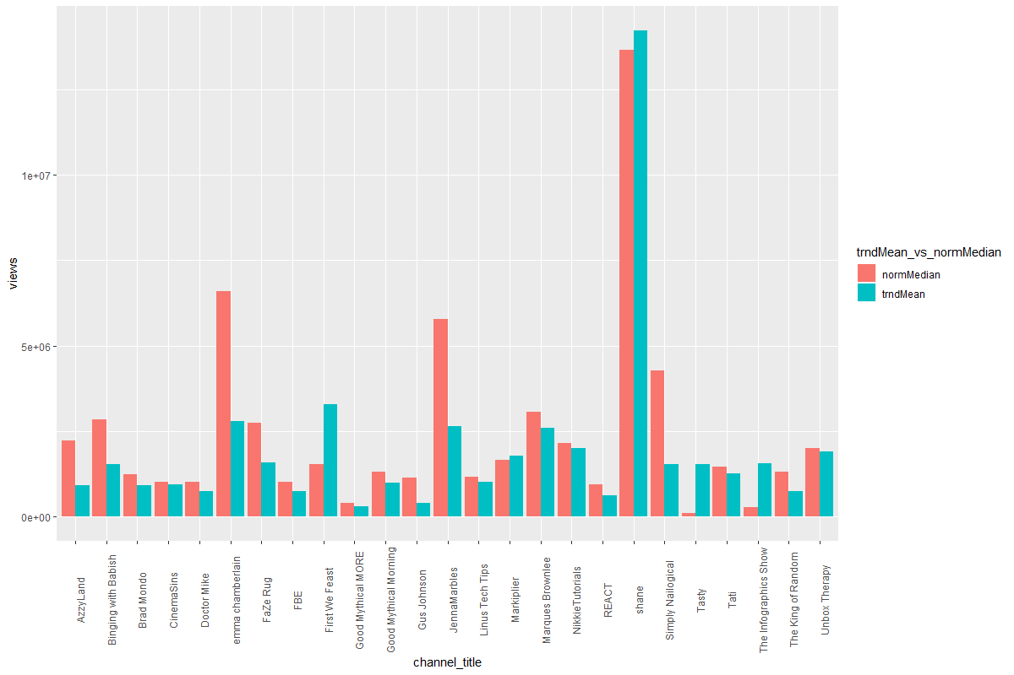
Youtuber view comparison

Slide 19
Traditional media companies
don’t have any “fans”.

Slide 20


Slide 21
The Curious Case of David Dobrik
14.7 million subscribers
Consistently popular videos
Rarely on trending

Slide 22
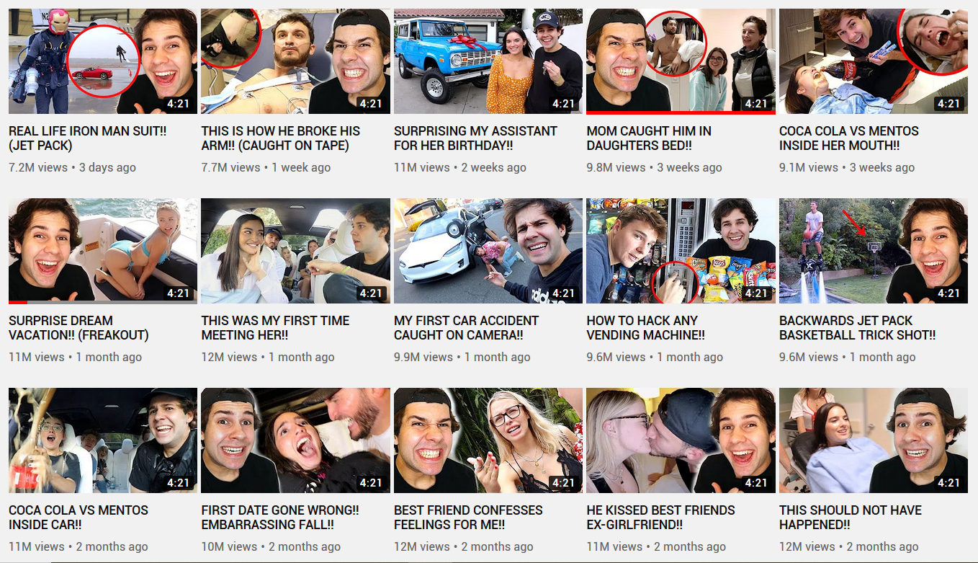

Slide 23
Videos trend not when they’re popular, but when they are being viewed by a very broad audience.

Slide 24
Youtuber view comparison

Slide 25
Questions?

